Slide 1
File system
CS 142
David Anderson
Slides by Martin Hock

Slide 2
RAM technology
Up until this point, our Java programs have only operated within RAM (random access memory) which can be accessed within billionths of a second
However, all RAM technologies in wide use are volatile: when the power goes out, RAM is erased
Furthermore, RAM is (somewhat) expensive: roughly $5/GB
Historically, RAM was extremely expensive: in 1981, 128K of memory was over $100 (so 1 GB was over $800,000)

Slide 3
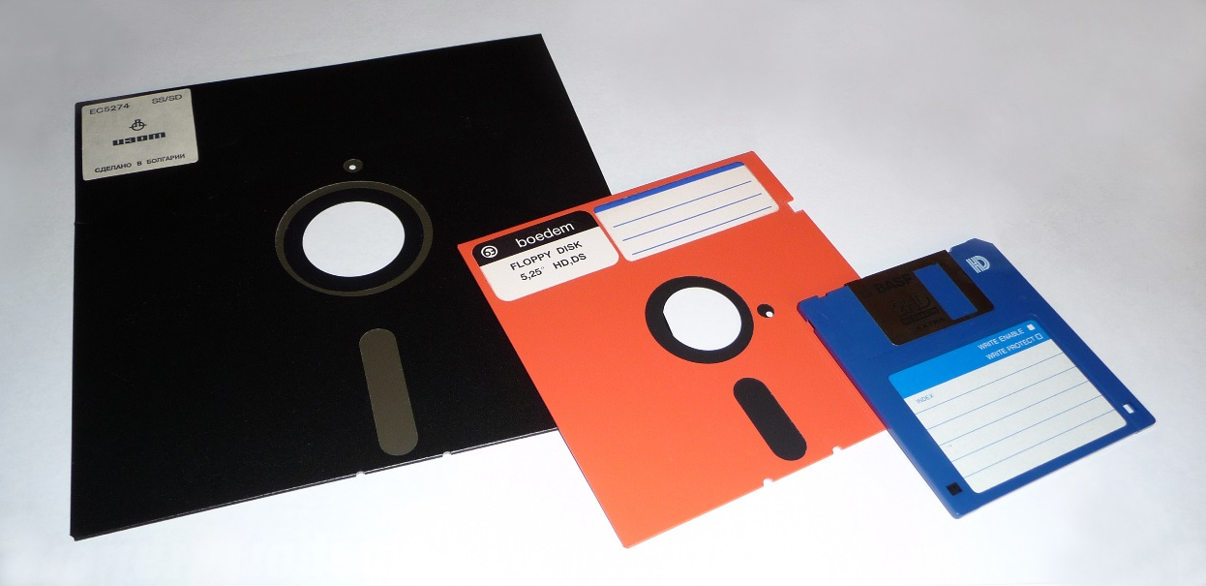
Disk
“Disk” is a generic term used for nonvolatile technology which is slower and cheaper than RAM
Historically, disks were spinning magnetic media
Floppy disks were very slow and held little information but were cheap and could be passed around
Fixed or hard disks, still in use today, have hard magnetic platters which spin at a high rate of speed (5400-15000 RPM)
Solid state disks based on flash memory technology also exist
More expensive but much lower latency
Limited number of rewrites

Slide 4
Organizing information
In RAM, our programs organize information as they use it
Memory layout can be somewhat messy because it only needs to be understood as it is being used
On disk, information must be reusable and readable
Since many programs may use the finite disk resource, we need a way of organizing information that can be shared and can be accessed outside the original program

Slide 5
File system
Disks may be partitioned into multiple pieces and each piece can have a different purpose (different operating system, recovery information, etc.)
File systems organizing information hierarchically on fixed disks
Information is organized into units called directories or folders which are identified by string representing their name
Folders can contain folders or files
Files, also identified by name, contain information (a document, a video, a Java program, etc.)

Slide 6
Path
We can describe a file’s location in terms of its path
On Windows computers, paths begin with a drive letter and colon (ordered from A to Z and beyond) which corresponds to a disk partition
On Linux, Android, Mac, and iOS, there is no drive letter
For historical reasons, the hard disk usually is drive C
A and B were floppy drives: two so you could copy floppies more easily
Directories are separated by a separator: on Windows, this is the backslash \
On Linux, Android, Mac, and iOS, it’s the slash /

Slide 7
Current directory
Windows, Mac, Linux, etc. have a notion of current directory for a given program
When the program is launched, it’s usually the directory where the program is located
This allows a program to access its associated files easily no matter where it is installed
Back in the old days, you could copy a program from a floppy to a hard disk and it would work the same way
A path can be relative to the current directory or absolute (paths with drive letters tend to be absolute)

Slide 8
Escape characters
We’ve seen some reference to special characters in Java
If a character literal or string literal contains a backslash, the Java compiler interprets the next character in a special way
'\n' is a new line character and '\\' is a literal backslash
The path C:\Windows\Notepad.exe is written as "C:\\Windows\\Notepad.exe"

Slide 9
File class
The File class represents files in Java (it can also refer to directories)
Java programs are intended to be portable (run on many operating systems), so File has some mechanisms to cope with the differences between operating systems
File is used for file system operations such as listing files in a directory and deleting files from disk
Create a File object using the File constructor and give it a string representing the path as an argument: new File(path)
The path can be relative or absolute

Slide 10
Streams
We have worked with System.in which is an InputStream object
A stream is an abstraction that represents an unknown (potentially large) number of characters or bytes that you read in order
Scanners work with Streams internally but you can construct a Scanner using a File object: new Scanner(file)
You can read from a Scanner working with a File the same way that you read from a Scanner working with System.in
Note that a File itself is not a stream, just a reference to a file
The readLine() method of Scanner will read a line of input into a String

Slide 11
Example: Reading a file in a loop
public static void main(String[] args) throws FileNotFoundException {
// Create a File object for C:\Users\Default\Documents\hiclass.txt
File notepad = new File("C:\\Users\\Default\\Documents\\hiclass.txt");
System.out.println(notepad.exists()); // True if file exists
System.out.println(notepad.length()); // Length of file in bytes
// Read all the lines of the file
Scanner s = new Scanner(notepad);
while (s.hasNextLine()) { // As long as there are more lines to read
String line = s.nextLine(); // Read the next line
System.out.println(line); // Print it out
}
}

